Slide 1
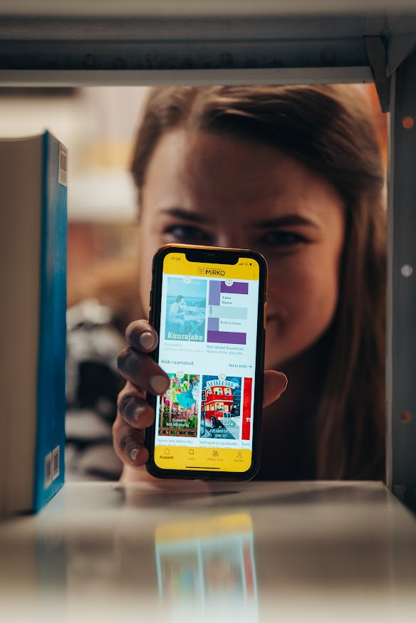
First year of Estonian national e-lending service MIRKO Kairi Felt National Library of Estonia

Slide 2
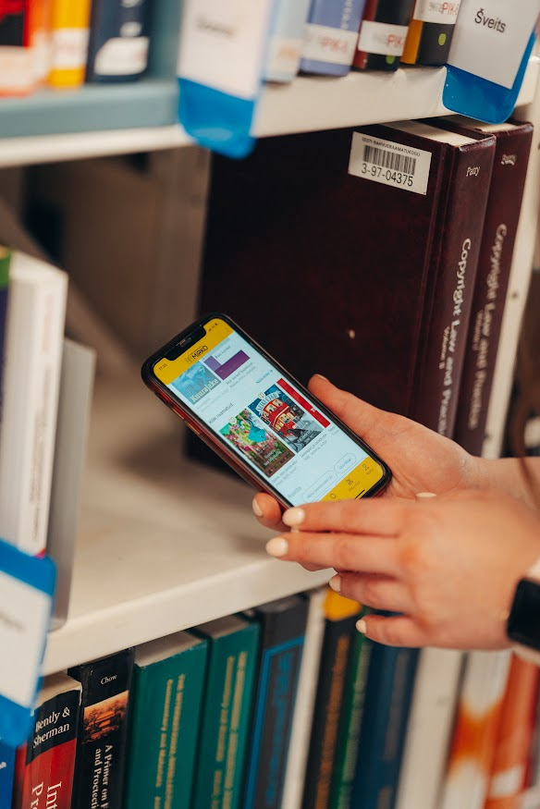
First year of MIRKO: content
4147 publications: 3760 e-books,
370 audiobooks, 17 titles of magazines
1 licence = 10 leases
audiobook license 38 euros,
e-book license 16 euros
fiction 76%, non-fiction 24%

Slide 3
First year of MIRKO: check-outs
More than 125 000 check-outs - 1/3 audiobooks and 2/3 e-books
Most popular crime fiction, thrillers, science fiction and romance novels
By subject – psychology, geography

Slide 4
First year of MIRKO: users
20 080 registered users - 70% women, 30% men
Age of users

