Slide 1
E-library in Finland – building a nationwide service

Slide 2
E-library as a service
Provided collaboratively by the National Library of Finland and Finnish municipalities (public libraries).
Supplies e-books and audiobooks in Finnish, Swedish and English and Finnish digital magazines.
Uses the E-library mobile app as the initial user interface.
Available to the residents of participating municipalities.
Set to enter service on 23 April 2024.

Slide 3
Funding & organisation
Municipalities fund the service as a whole (€0.70 per resident a year).
When it opens, the service is estimated to be available to 85% of people living in Finland.
Municipalities to have joined the service: 220
Total residents: 4,6 M
The service is provided in cooperation with public libraries: 10 working groups and a steering group.

Slide 4
The National Library’s E-library unit
Service Manager
Three Information Specialist (library collaboration, contents, communications)
System Manager
Four system specialists

Slide 5
Collaboration with public libraries
10 working groups:
Content selection groups (six total)
Collection group (consisting of chairs of material selection groups)
User support group
Front-page editorial group
Communications and marketing group
User training group

Slide 6
License models
Primary model: annual license for limited simultaneous use
For Finnish titles, 5, 10, 30 or 50 simultaneous reading rights
For Swedish and English titles, 1, 10 or 30 simultaneous reading rights
Potential additional models:
A pool model (e.g., 100 loans)
A pay-per-view model: a fee charged for each loan
A permanent license model for limited simultaneous use
A hybrid model: a combination of several approaches
For magazines, a floating license for limited simultaneous use
License type offered by and fees determined by each publisher

Slide 7
Content budget
Content budget depending on the number of participating municipalities
Estimated at €2–3 million per year
Content budget 2024 about €1.3 million per 7 months
The contents allowance has been distributed on the basis of a cost survey in the E-library project and of previous usage statistics.

Slide 8
Content selection
Working groups responsible for content selection, six groups:
Magazines
Finnish-language fiction
Finnish-language non-fiction
Finnish-language children’s and young adult literature
Swedish-language literature
Literature in English and other languages
Group members consist of Finnish public library staff.
The groups select contents regularly at least on a monthly basis.
The group chairs constitute the E-library collection group, responsible for the E-library collection policy.

Slide 9
Becoming a customer
Account creation through the app with strong authentication
Personal data from the Suomi.fi service
Municipality of residence, name, personal identity code
Information on any dependent children
Equivalent to the signature and ID card required for a library card application
Accepting the terms of use
Accepting the updating of personal details via Suomi.fi

Slide 10
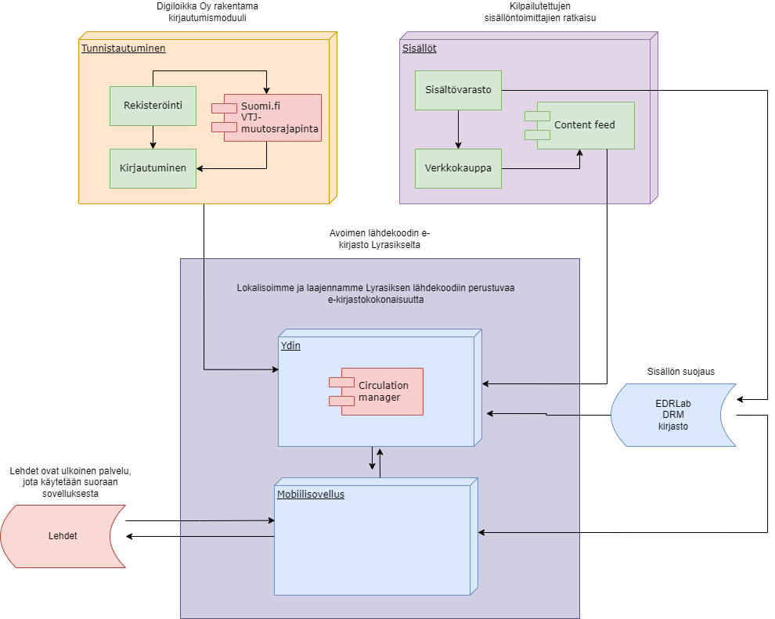
E-library app technology
The E-library service is based on open source code (Lyrasis, the Palace Project)
Extended with local components
An authentication solution
Suomi.fi, PIS modified data interface
Digital magazines
Usage statistics for municipalities and for public lending remuneration
Maintained and developed by the E-library service
Ellibs created the app up to the publishing stage
Resources from supplier services through an interface
Metadata, unenriched
Availability
Lisence management

Slide 11
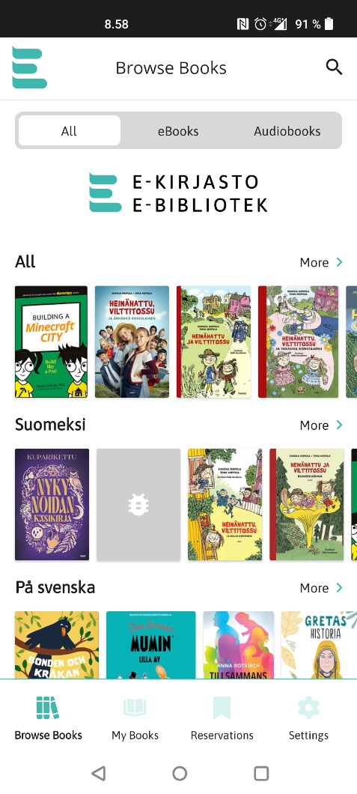
E-library app
Downloadable for Android and iOS devices from Google Play and Apple Store
The aim has been to make the app as easy as possible to use.
Basic features: browsing, borrowing, reserving, reading and listening to resources
Notes:
E-books and audiobooks are accessed in the app.
Offline use
Magazines are opened for reading in an external software solution.
Magazine reading requires an uninterrupted internet connection.

Slide 12
Special features of the E-library
The service need was identified by libraries, and initial funding came from parliament.
The app has been created and is maintained and further developed by libraries.
The platform and contents are separate.
Libraries have played a major role in producing and developing the service.
Stakeholders have been consulted extensively in creating the service, and collaboration with them will continue.
In Finland, public lending remuneration is currently paid for e-resources.

Slide 13
Yhteystiedot
Emails
firstname.lastname(at)helsinki.fi
Customer service email
e-kirjasto-posti(at)helsinki.fi
Customer wiki
www.kiwi.fi/display/ekirjasto
Website
E-kirjasto.fi
E-biblioteket.fi
E-library.fi

Slide 14
Accessibility
The app meets the WCAG accessibility conformance levels A/AA.
Perceivable
Operable
Understandable
Robust
For resources, the accessibility requirement applies only to e-books.
As of June 2025
Accessible DRM
Readium LCP DRM (Licensed Content Protection)
Accessibility considered for audiobooks
Readium audiobook, enriched MP3
Accessibility considered for magazines, where possible
Listening enabled for some articles in certain magazines
Resource accessibility depends on file structure as well

