Slide 1
NAPLE WG Library services for, with and by persons identifying as bearer of a Regional or Minority Language

Slide 2
2022
2 meetings, May and October:
Presentations of work in Sweden,
Discussions,
Main focus: Raise awareness

Slide 3
Why WG?
On a global scale,
one language disappears forever every two weeks.
Before the end of this century some 3 000 languages will disappear unless the global community makes an effort to preserve as many as possible.
The Charter from the Council of Europe
article 12: cultural activities and facilities mentions especially libraries and video libraries, and states that they play an important role in this field.
UN declaration of Human Rights
article 2
Convention on the Rights of the Child
article 17.d and 30
Agenda 2030
“leave no one behind” 10.2, 10.3, 11.4, 12 B, 16
UNHCR
– Safeguarding individuals

Slide 4
2023-2024
Cultural and linguistic diversity are fundamental assets of the EU and are to be respected, promoted and enhanced, including through mobility and the circulation of works.
(The EU Work Plan for culture, guiding principles)
Increase participation within NAPLE
Raise awareness in the European library sector
Webinars
Blog postings
Share examples
Advocacy

Slide 5
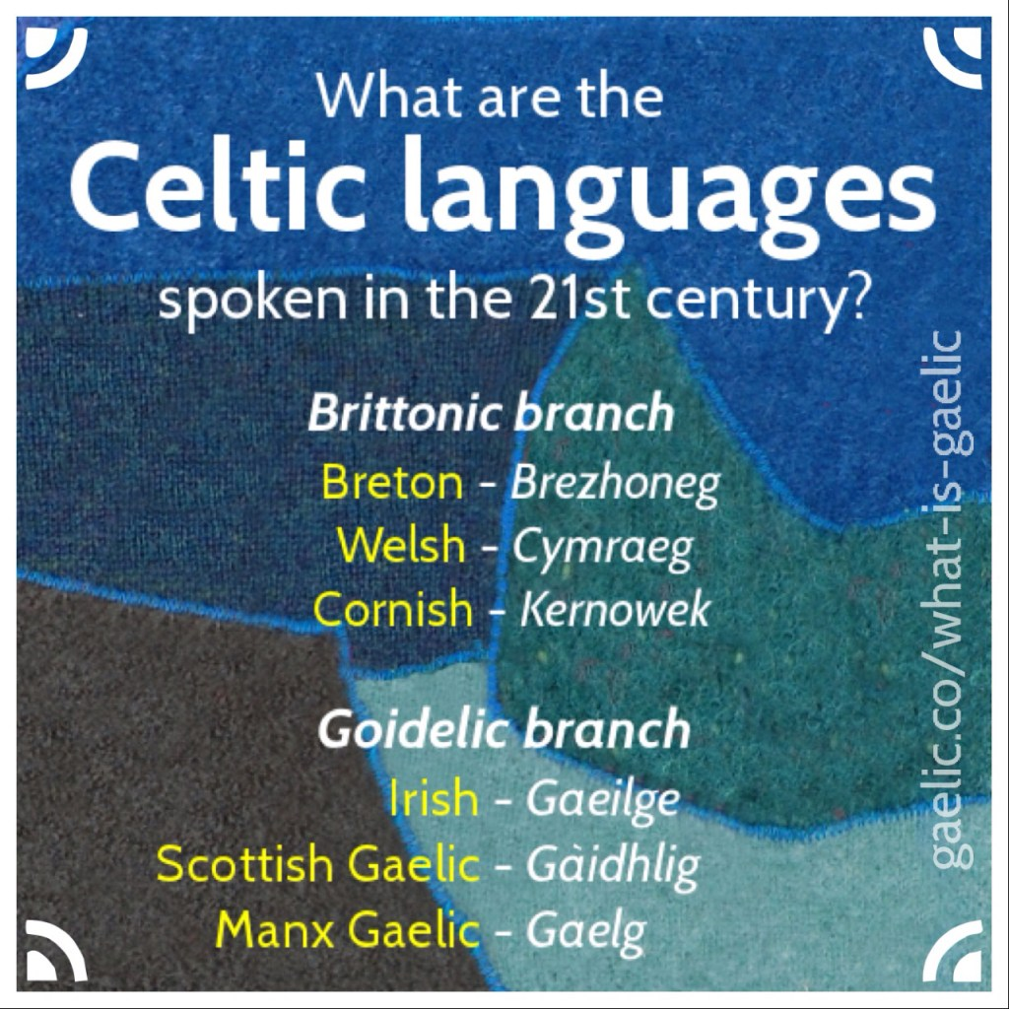
The name of WG
Language with official status of a national language, but in need of special considerations to keep the language alive
Estonian, dialects Greenlandic (Denmark) Scottish Gaelic
(Small) languages without official status
Travellers / Sinti / Roma
Change name to be even more inclusive?

Slide 6
Discussion
Participation
Changing the name of WG?
A NAPLE statement?
Elisabet.Rundqvist@kb.se

Slide 7
The Charter
Regional and minority languages are part of Europe's cultural and intangible heritage.
The Council of Europe adopted the European Charter for Regional or Minority Languages in 1992:
Are aware that their protection and promotion contribute to the construction of a Europe based on respect for human rights, democracy and the rule of law.
Obliges the 25 States Parties that have ratified it to actively promote the use of these languages in education, justice, administration, media, culture, economic and social life and cross-border cooperation.

Slide 8
IFLA/UNESCO Multicultural Library Manifesto:
Serve all members of the community without discrimination based on cultural and linguistic heritage;
Provide information in appropriate languages and scripts;
Give access to a broad range of materials and services reflecting all communities and needs;
Employ staff to reflect the diversity of the community, who are trained to work with and serve diverse communities.

Slide 9
#Europe4Libraries2019
Guarantees that everyone, at any time in their lives, is able to learn, read, and develop through libraries.
Equity across Europe is key.
To achieve this, it should help realise the potential of libraries to ensure that everyone has access to initiatives and projects that promote reading, literacy and learning for all.

