Slide 1
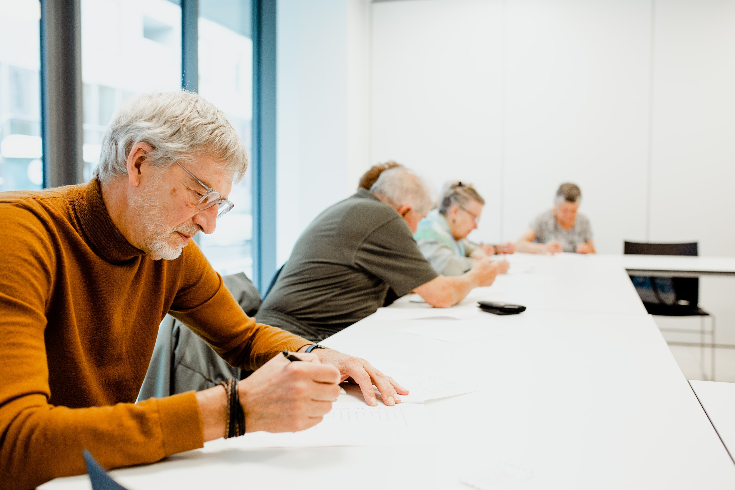
E-books in Flanders: digital reading and the elderly population

Slide 2
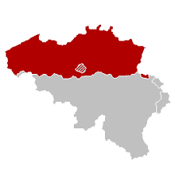
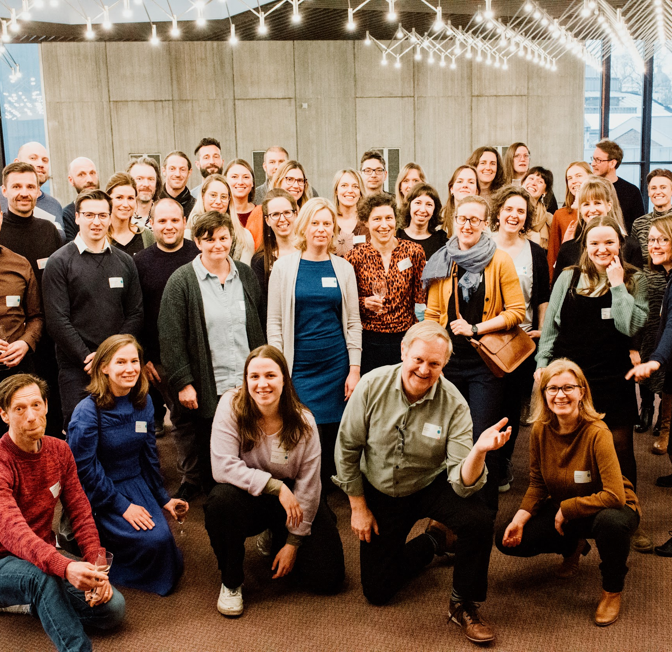
Cultuurconnect
Flanders & Brussels
Digital Innovation
Cooperation
(with libraries & performing art centers)

Slide 3
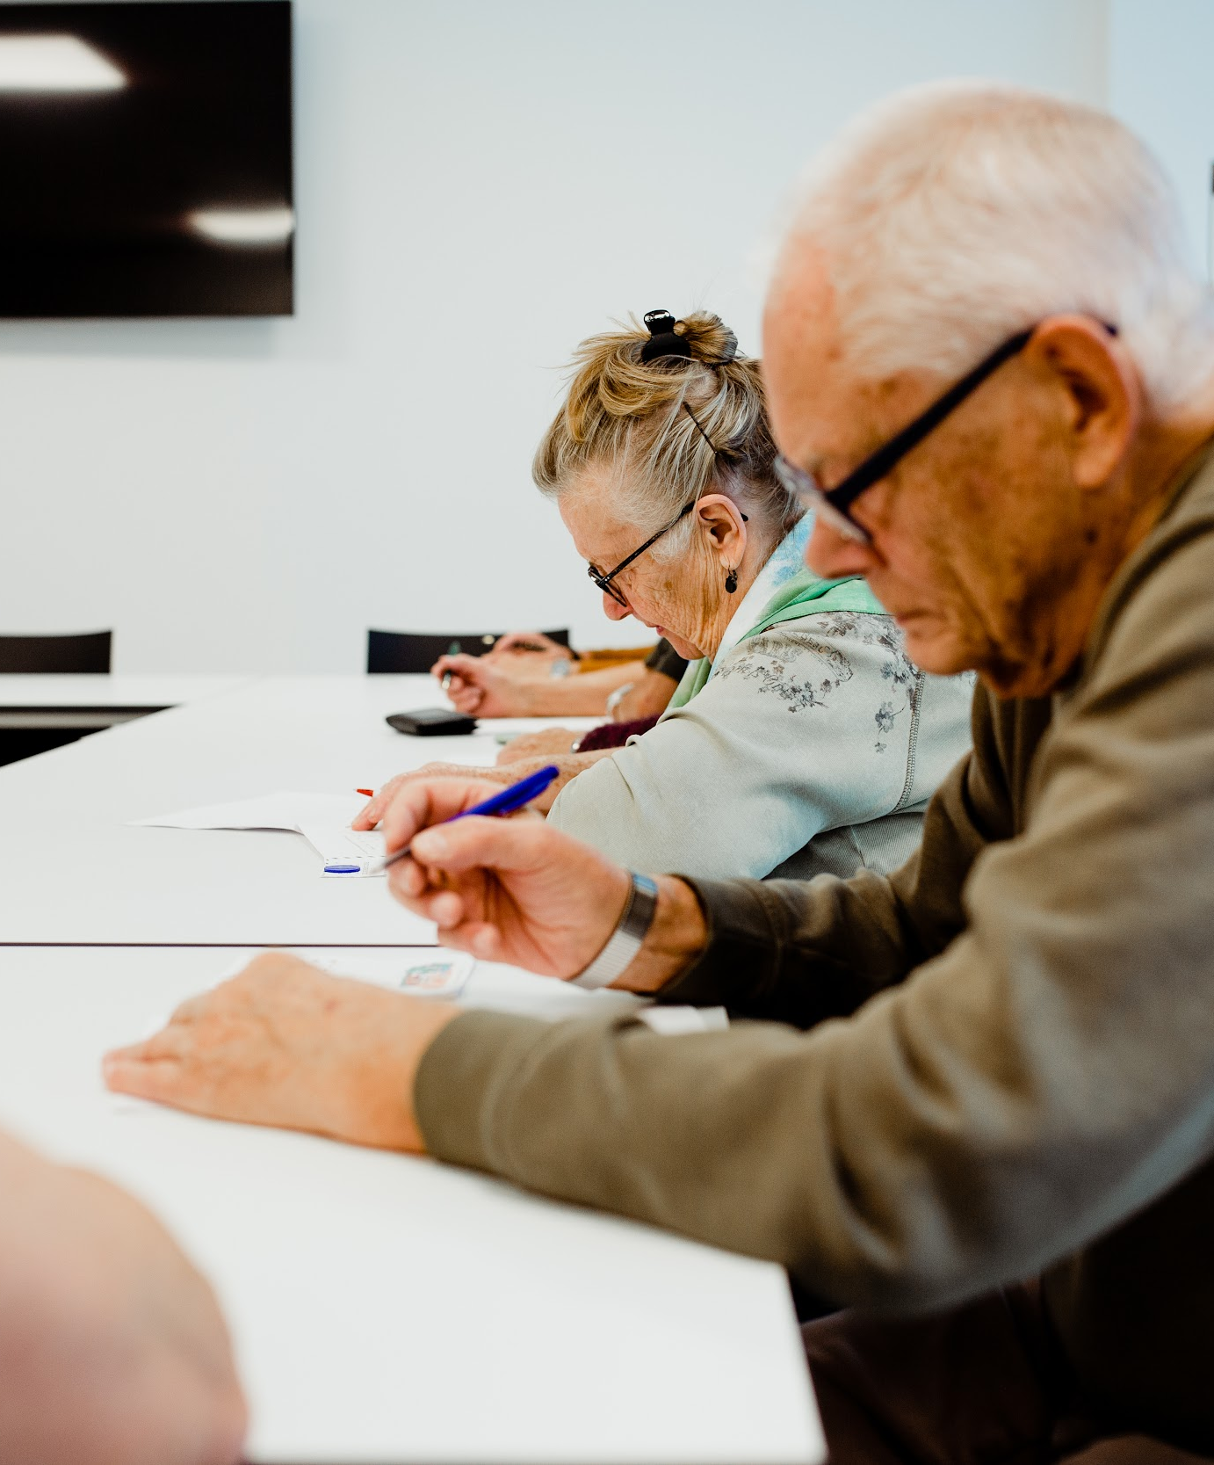
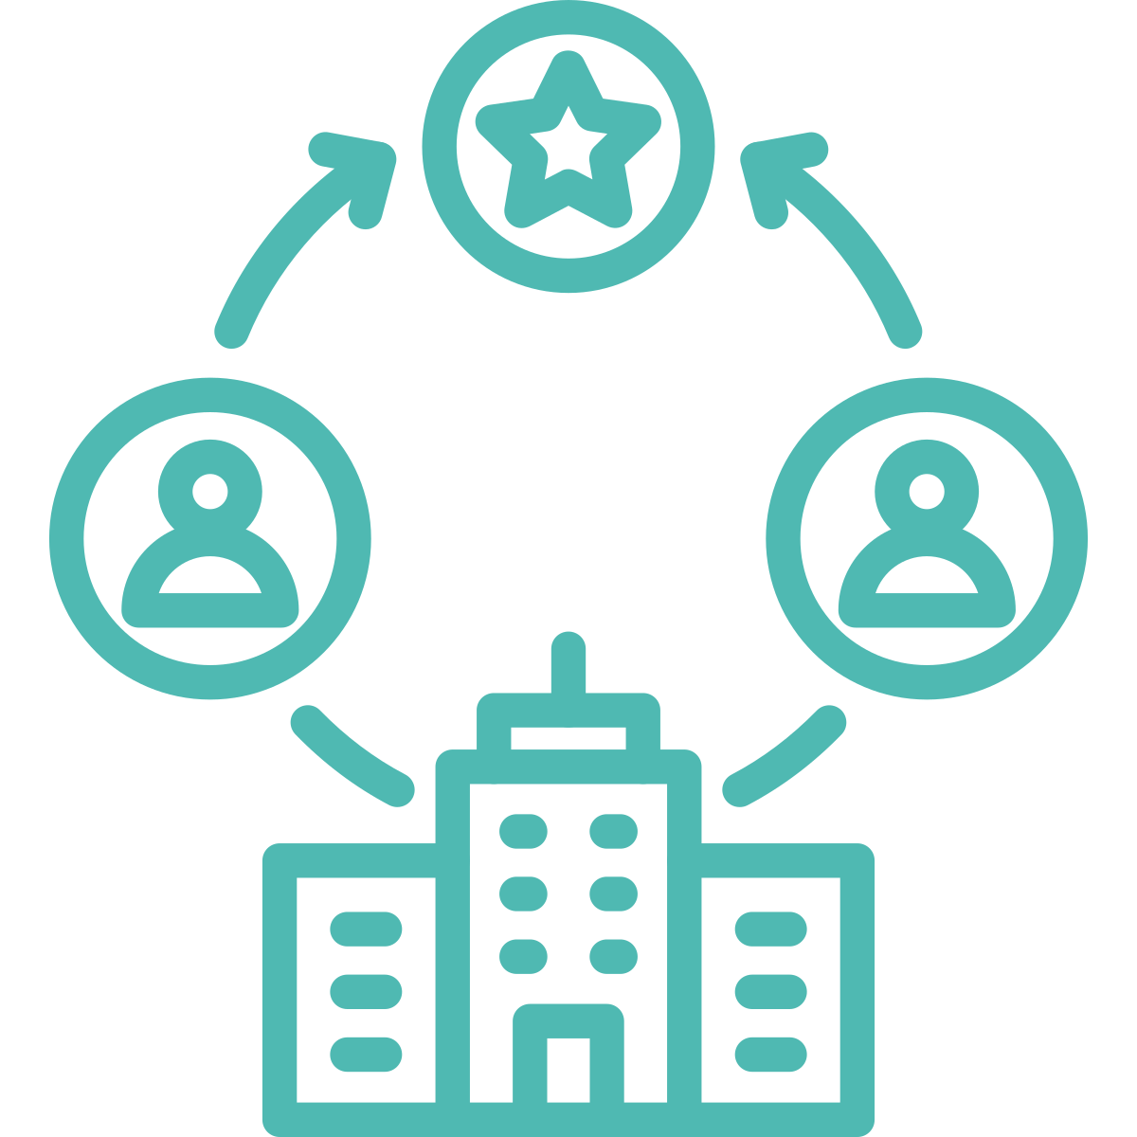
Project Odile
Online digita(a)l lezen (~reading)
Research
Improvements
Approach
Training program

Slide 4
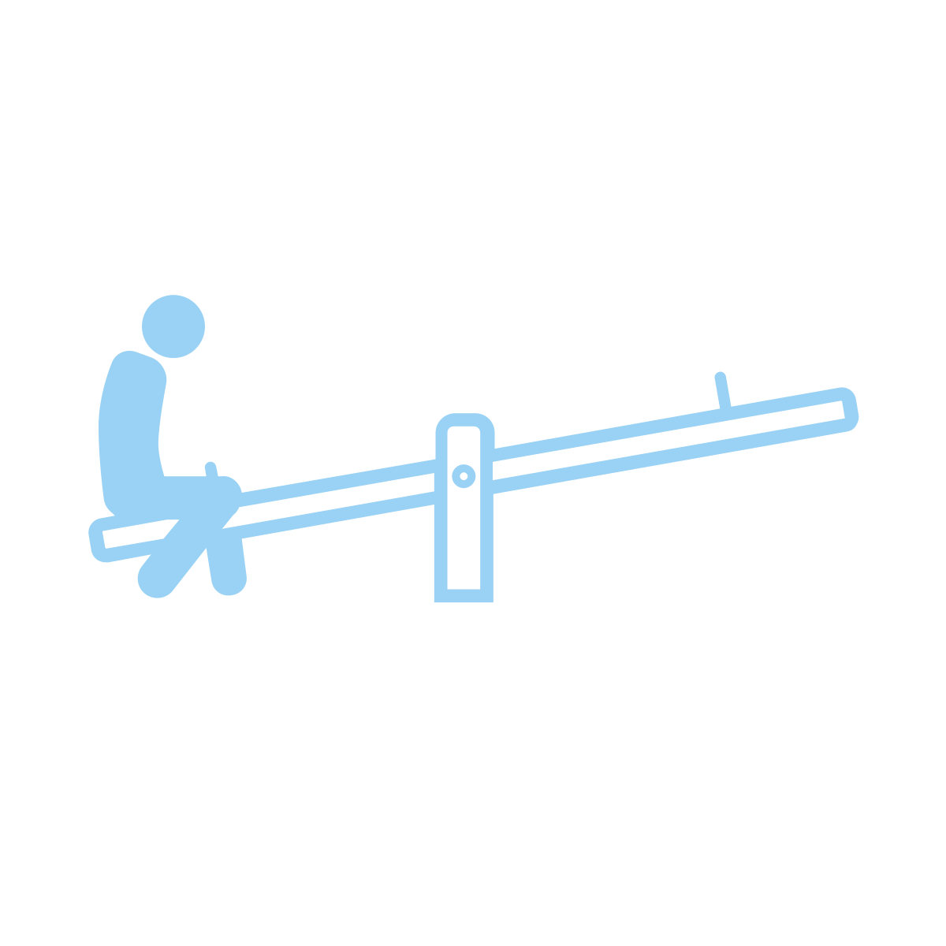
Research: digital reading and the elderly population
Low digital skills
→ digital reading support can be an answer
Physical issues
→ digital reading can be an answer
A lot of loneliness
→ digital reading support/groups can be an answer

Slide 5
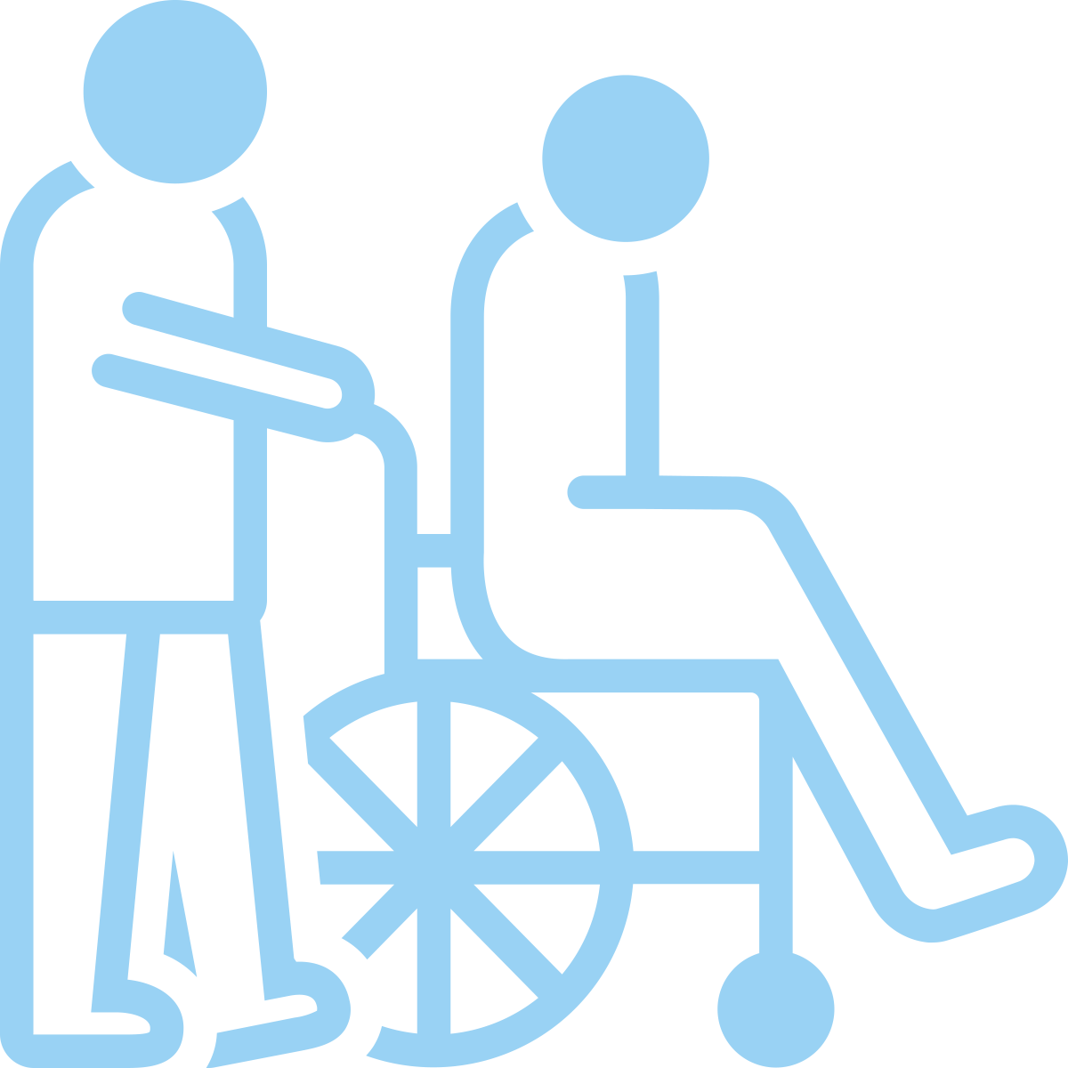
Improvements
Focus on 50-60+ to improve digital skills
Collaboration with caretakers / healthcare facilities
Technical improvements

Slide 6
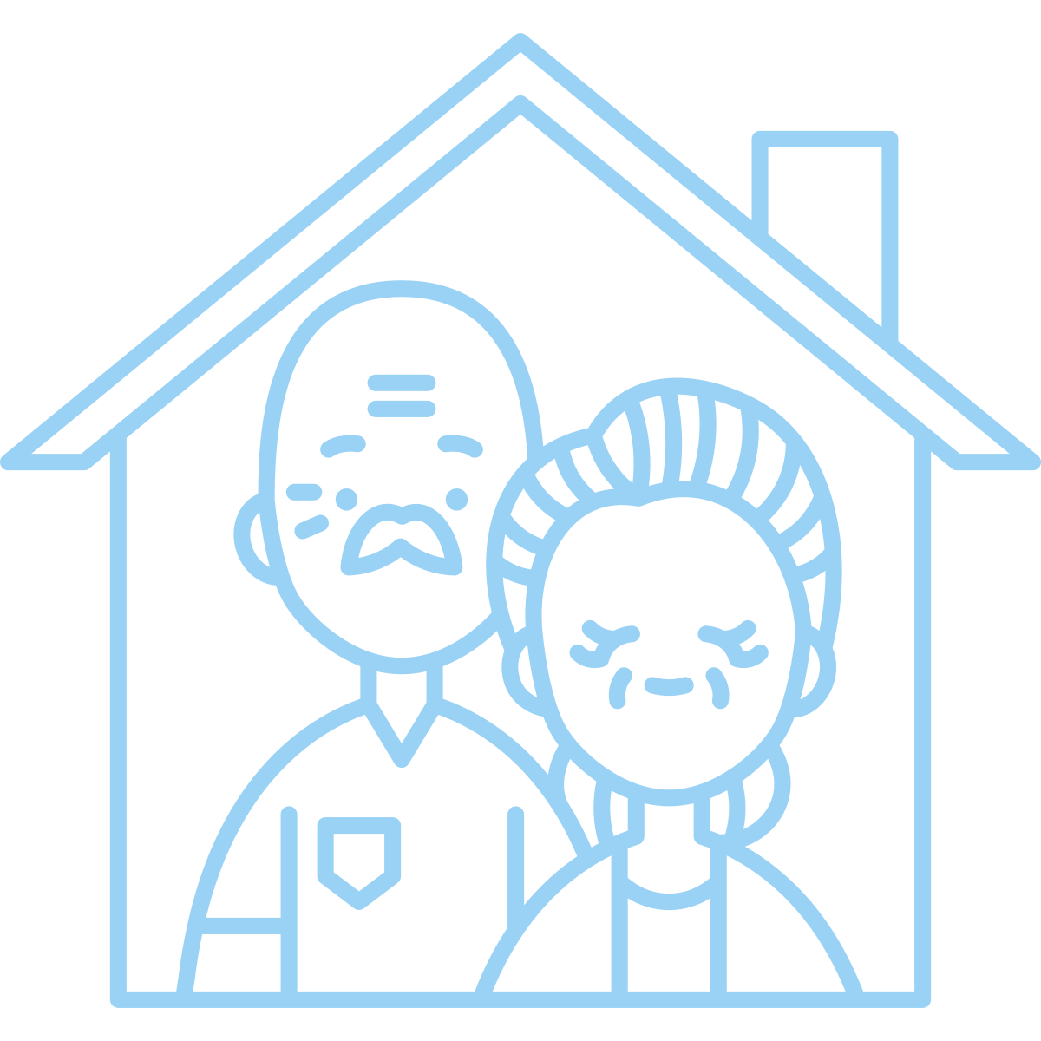
Training program
For the library employees
For library members
For caretakers

Slide 7
Promotion of digital reading: focus on 50-60+
In the library
In newspapers/magazines

Slide 8
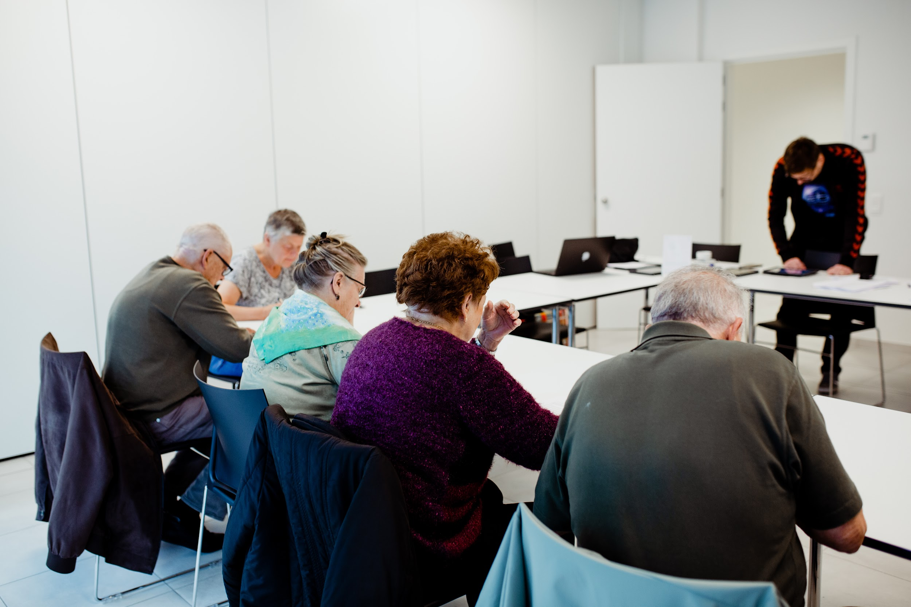
Learning together
Digital skills lab
Public library, Lier

Slide 9
2023: statistics
60.000 unique users (borrowed at least 1 e-book)
600.000 loans
38% is 60+
15% of our loans are foreign languages

Slide 10
2023-2024: on to a new balance
dialogue
more transparency
a covenant
more European cooperation
e.g. for foreign-language content?

Slide 11
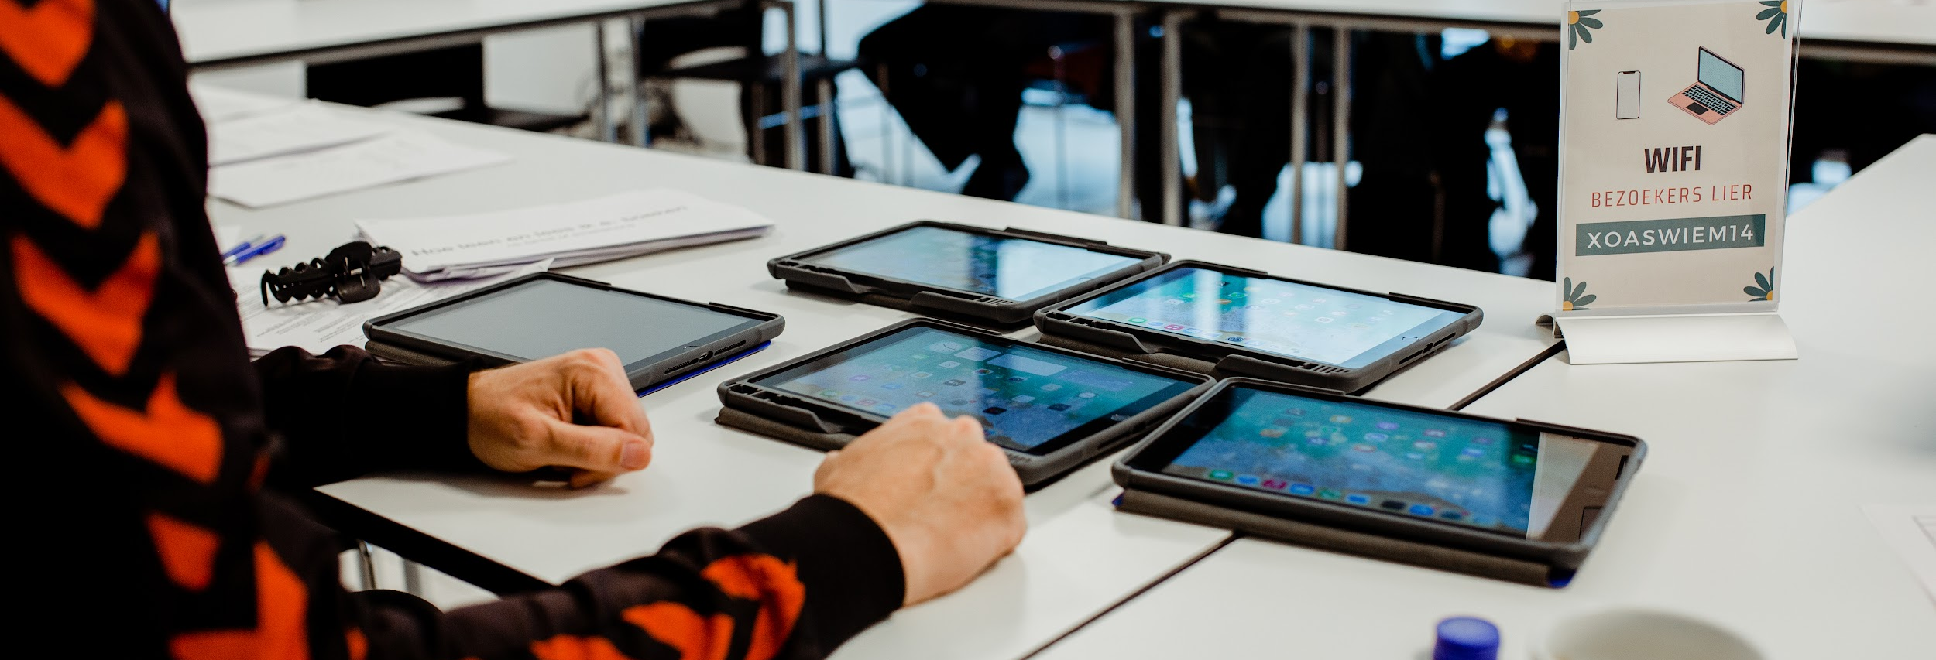
Thank you!
gwenny.vlaemynck@cultuurconnect.be

